Slide 1
INFORMATION SECURITY
Public-Key Cryptosystems
1

Slide 2

Presentation by
Sunaan Sultan (ASH1925004M)
ollllllllllllllllllllllllllllllllllll Kanti Bakshi(ASH1825018M)
Supervised by
Falguni Roy
Assistant Professor, IIT, NSTU
2

Slide 3
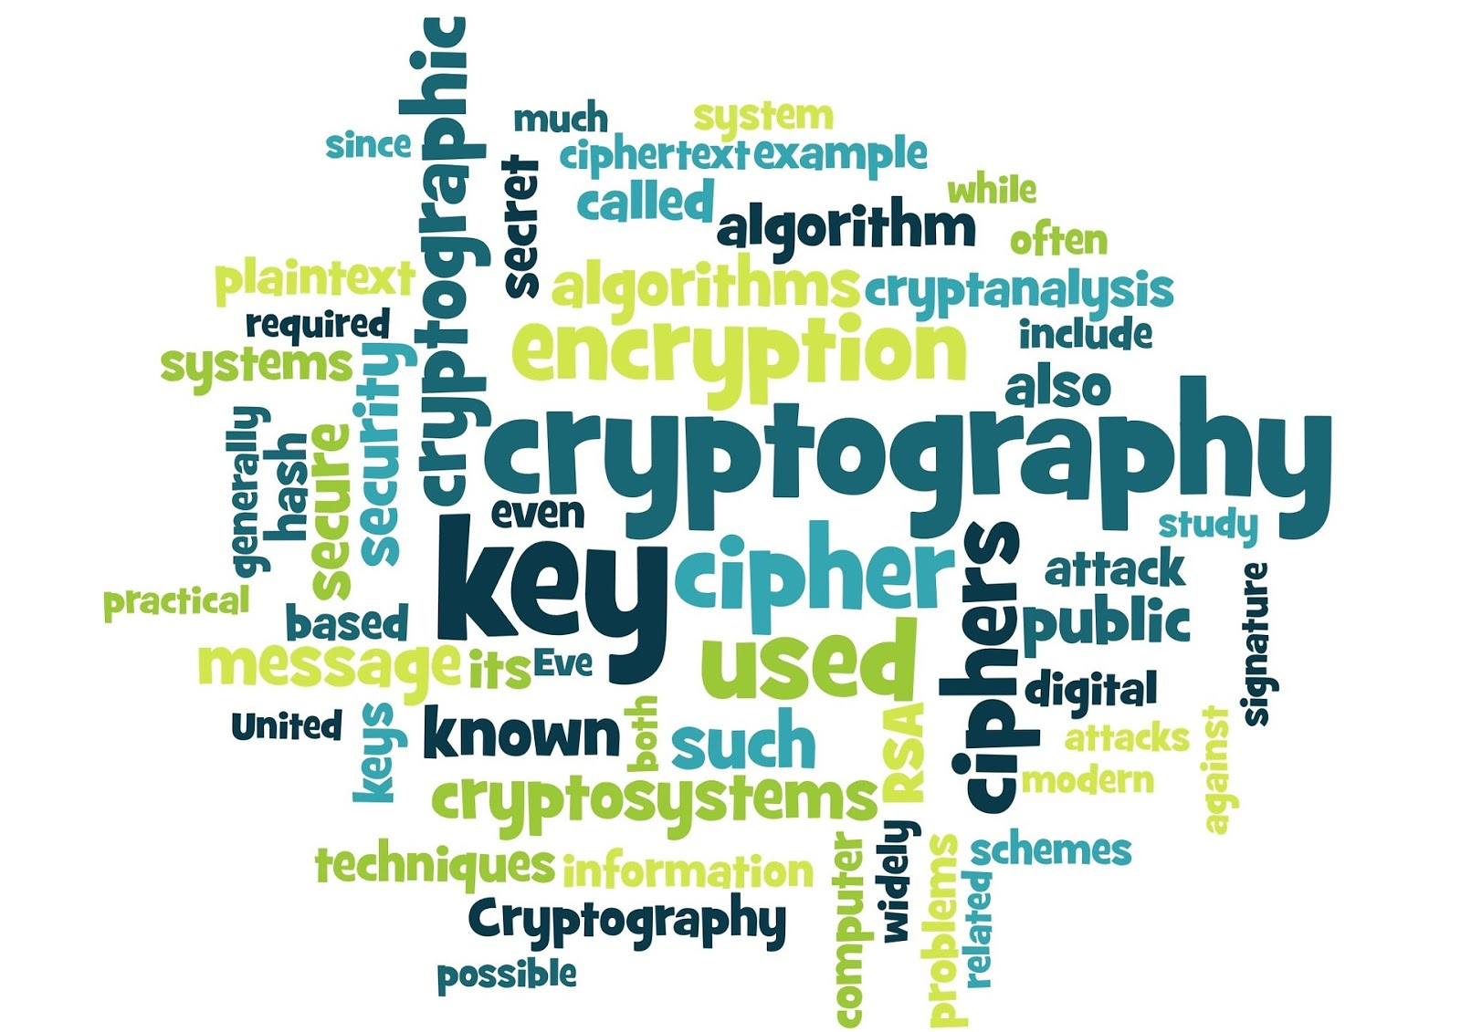
Contents
OVERVIEW OF THE TOPICS
The RSA Cryptosystem
Proof of RSA
Approaches to attacking RSA
Public Key Infrastructure
3

Slide 4
Invented by Ron Rivest, Adi Shamir, and Len Adleman, the RSA cryptosystem was first revealed in the August 1977.
The RSA is most commonly used for providing privacy and ensuring authenticity of digital data.
RSA is used by many commercial systems. It is used to secure web traffic, to ensure privacy and authenticity of Email, to secure remote login sessions, and it is at the heart of electronic credit-card payment systems.
The
RSA
Cryptosystem
4

Slide 5
It’s an asymetric cryptography system. So 2 keys, Public and private key concept is used here.
The
Rsa
Cryptosystem
Public key : Known to all users in the network.
Private key : Kept secret, not sharable to all.
If public key of user A is used for encryption, we have to use the private key same user for decryption.
The RSA scheme is a block cipher in which the plaintext and ciphertext is integers between 0 and n-1 for some value n.
5

Slide 6
The RSA Algorithm
Choose two prime numbers p and q,
Compute the modulus in which the arithmetic will be done: N=pq,
Eulers Totient Function : ϕ(n)=(p−1)(q−1)
Pick a public encryption key e : 1<e<ϕ(n) such that gcd (ϕ(n),e) =1
Compute the private decryption key as d such that ed=1modϕ(N),
Encryption of message m: C=Me mod N,
Decryption of crypto message c: M=C^{d} mod N.
6

Slide 7
Proof of RSA
Euler’s Theorem: If x is relatively prime to n then x^φ(n) = 1 mod n.
Recall that,
ed = 1 mod (p − 1)(q − 1)
and
φ(N ) = (p − 1)(q − 1).
These two facts together imply that
ed − 1 = kφ(N )
for some integer k
Now we have all of the necessary pieces of the puzzle to verify that RSA decryption works. We have C^{d} = M^{ed} = M^{(ed-1)+1}= M · M^{ed-1} = M · M^{kø(N)} =M· 1^{k} = M mod N
where we have used Euler’s Theorem to eliminate the ominous looking term M^{ø(N)} This confirms that the RSA decryption exponent does, in fact, decrypt the ciphertext C.
If Me < N
Then,
C = Me mod N = Me
If Me > N
Then,
C = Me mod N
7

Slide 8
Proof of RSA
Let’s consider a simple RSA example. To generate, say, Alice’s keypair, we select the two “large” primes, p = 11 and q = 3. Then the modulus N = pq = 33 and (p − 1)(q − 1) = 20. Next, we choose the encryption exponent e = 3, which is relatively prime to (p − 1)(q − 1). We then compute the corresponding decryption exponent, which is d = 7, since ed = 3 · 7 = 1 mod 20. We have
Public key: (N , e) = (33, 3)
and
Private key: d = 7.
Now suppose Bob wants to send Alice the message is M = 15. Bob looks up Alice’s public key (N , e) = (33, 3) and computes the ciphertext C as
C = Me mod N
=15³ mod 33
= 9
which he then sends to Alice. To decrypt the ciphertext C = 9, Alice uses her private key d = 7 to find
M = C^{d} mod N
= 9⁷ mod 33 = 15
and Alice has recovered the original message M from the ciphertext C.
d = (1+k φ(N ) ) / e ; k= 0, 1, 2 …
8

Slide 9
Approaches to attacking RSA
Brute force Attack
Mathematical Attacks
Timing Attacks
9

Slide 10
Approaches to attacking RSA
Brute-Force Attack
If the RSA key is too short, the modulus can be factored by just using brute force. Factoring 1024-bit keys is definitely not possible in a reasonable time with reasonable means, but may be possible for well equipped attackers. 2048-bit is secure against brute force factoring.
Timing Attacks
In a timing attack the attacker attempts to compromise a cryptosystem by analyzing the time taken to execute cryptographic algorithms. Every logical operation in a computer takes time to execute, and the time can differ based on the input; with precise measurements of the time for each operation, an attacker can work backwards to the input. Finding secrets through timing information may be significantly easier than using cryptanalysis of known plaintext, ciphertext pairs. Sometimes timing information is combined with cryptanalysis to increase the rate of information leakage.
10

Slide 11
Approaches to attacking RSA
Mathematical Attacks
Factoring Large Integers
Attack on RSA public key (N, e). After getting the factorization of N, an attacker can easily construct φ(N), from which the decryption exponent d = e-1 mod φ(N) can be found. Although factorizing the modulus has been improving, the current state of the art of this attack is unable to post a threat to the security of RSA when RSA is used properly.
Guessing d
This time the attacker knows both the plaintext and ciphertext (they simply has to encrypt something). They then try to crack the key to discover the private exponent, d. This might involve trying every possible key in the system on the ciphertext until it returns to the original plaintext. Once d has been discovered it is easy to find the factors of n. Then the system has been broken completely and all further ciphertexts can be decrypted.
11

Slide 12
Approaches to attacking RSA
Searching the Message Space
One of the seeming weaknesses of public key cryptography is that one has to give away to everybody the algorithm that encrypts the data. If the message space is small, then one could simply try to encrypt every possible message block, until a match is found with one of the ciphertext blocks. In practice this would be an insurmountable task because the block sizes are quite large.
12

Slide 13
Public key infrastructure is a system of policies, procedures, people, hardware, software and services that support the use of public key cryptography to obtain secure communication. It is the sum total of everything required to securely use public key crypto.
Public Key Infrastructure
13

Slide 14
PKI is security architecture provides an increased level of confidence to exchange information over Internet through the use of public and private cryptographic key pairs
About Public Key Infrastructure
PKI provides Data integrity, data confidentiality, strong authentication, and Electronic transactions protection against identity fraud
PKI leverage Data Protection as it is compliant with e-transaction laws
14

Slide 15
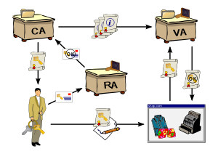
Diagram of PKI
15

Slide 16
Components of PKI
An anatomy of PKI comprises of the following components.
Public Key Certificate, commonly referred to as ‘digital certificate’.
Private Key tokens.
Certification Authority.
Registration Authority.
Certificate Management System.
16

Slide 17
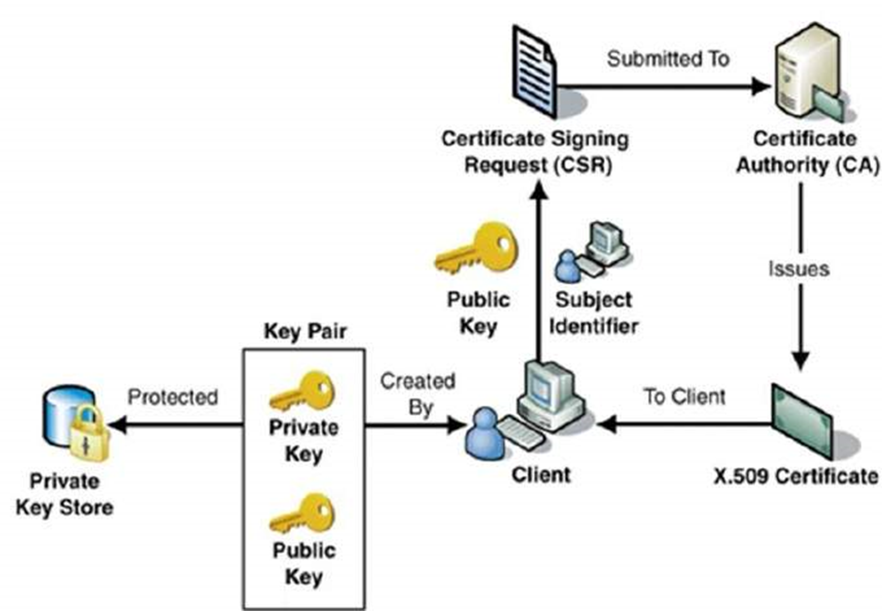
Digital Certificate
17

Slide 18
While the public key of a client is stored on the certificate, the associated secret private key can be stored on the key owner’s computer. This method is generally not adopted. If an attacker gains access to the computer, he can easily gain access to private key.
Private Key tokens
18

Slide 19
It is the management system through which certificates are published, temporarily or permanently suspended, renewed, or revoked. Certificate management systems do not normally delete certificates because it may be necessary to prove their status at a point in time, perhaps for legal reasons. A CA along with associated RA runs certificate management systems to be able to track their responsibilities and liabilities.
Certificate Management System (CMS)
19

Slide 20
Registration Authority (RA)
CA may use a third-party Registration Authority (RA) to perform the necessary checks on the person or company requesting the certificate to confirm their identity. The RA may appear to the client as a CA, but they do not actually sign the certificate that is issued.
20

Slide 21
Certifying Authority (CA)
The CA issues certificate to a client and assist other users to verify the certificate. The CA takes responsibility for identifying correctly the identity of the client asking for a certificate to be issued, and ensures that the information contained within the certificate is correct and digitally signs it.
21

Slide 22
Trust Models
A basic issue in public key cryptography is determining whose signature you are willing to trust. There are several possible trust models that can be employed.
monopoly model
Perhaps the most obvious trust model is the monopoly model, where one universally trusted organization is the CA for the known universe.
oligarchy model
The oligarchy model is one step away from the monopoly model. In this model, there are multiple trusted CA. In fact, this is the approach that is used in Web browsers today.
anarchy model
At the opposite extreme from the monopoly model is the anarchy model.
22

Slide 23
Thank you

